Slide 1
Web Application Development II
Week 10: Testing
10a: Unit Testing of JavaScript Functions using Vitest

Slide 2
Agenda
Learning Outcomes
By the end of this lesson, you can explain the following:
Verification vs. validation
Regression testing
Test-Driven Development
Load testing
Different types of testing: Unit testing vs. integration testing vs. E2E testing.
Write & run a unit test for a JavaScript function using Vitest.
Be familiar with how to use the following functions in test scripts: describe(), it()/test(), expect(), toBe(), and other matchers such as toBeTruthy(), toHaveLength() etc.
Definitions and Concepts
Unit Testing: Functions
Component & Integration Testing
E2E Testing

Slide 3
1. Definitions & Concepts
Verification example
A requirement states: "The system shall lock a user account after five consecutive failed login attempts."
The design and source code are reviewed to confirm that:
the threshold is exactly 5 attempts,
the lockout mechanism has been implemented correctly, and
the implementation matches the specification.
This is verification because you are checking that the software has been built according to the specified requirements.
Validation example
Suppose the software correctly locks the account after 5 failed attempts, but users complain that they frequently mistype passwords on mobile devices and are being locked out too often. After gathering user feedback, the team changes the policy to allow 10 failed attempts or to use CAPTCHA before locking the account.
This is validation because you are determining whether the product satisfies the users' actual needs.
Verification vs. Validation:
Verification = "Are we building the product right?". Ensures the software conforms to specifications and design documents. Focuses on correctness. Usually performed during development.
Validation = "Are we building the right product?". Ensures the software meets the users' needs & requirements. Focuses on fitness for purpose. Usually performed near/after completion of development.
Software testing involves both verification & validation to ensure that software is both correctly implemented & fit for intended use.

Slide 4
Regression Testing
"Retesting" verifies that a specific bug has been fixed using test cases related to the bug. whereas "regression testing" verifies that existing features still work after changes are made - includes testing both changed & unaffected functionality.
Modern software teams automate regression tests using tools such as:
JUnit (for Java), pytest (for Python)
Selenium, Cypress, Playwright (for Web apps)
Automated regression testing is integrated into a CI/CD pipeline so that tests run automatically whenever developers commit new code.
Regression testing = process of re-executing previously passed test cases after modifications are made to software to verify that existing features continue to function as expected.
Even a small change in one part of the code can unintentionally affect another part. Regression testing helps detect these unintended side effects.

Slide 5
Test-Driven Development (TDD)
TDD = Software development practice that emphasizes writing tests before writing the actual code.
It follows a cyclical process of writing an automated test, writing the minimum code to make the test pass, and then refactoring the code.
This cycle is often referred to as the "Red-Green-Refactor" cycle.
Write a Test (Red): start by writing a test that defines the behavior you want to implement. This test should initially fail because you haven't written the corresponding code yet.
Write the Minimum Code (Green): write the simplest code necessary to make the test pass. This code need not be perfect.
Refactor (Refactor): refactor the code to improve its structure, readability, and performance while ensuring that the tests continue to pass.
TDD applies to Unit Testing

Slide 6



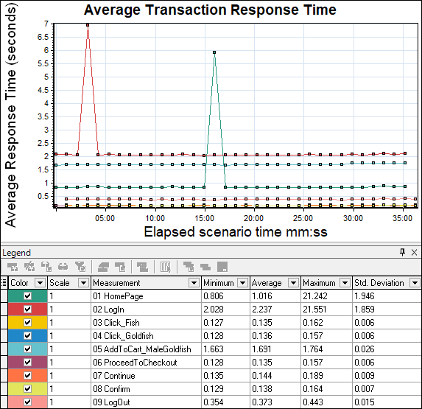
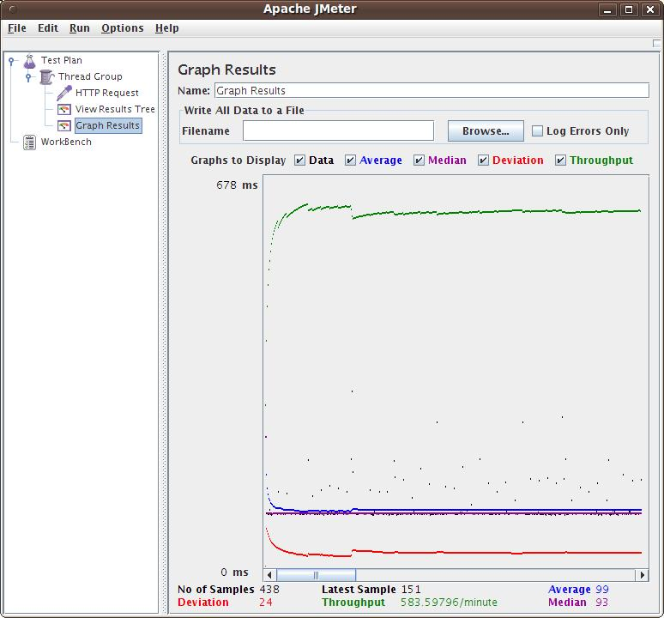
Load Testing
A load testing tool simulates multiple concurrent virtual users executing realistic user scenarios to evaluate a system's performance under load. A virtual user is a process or thread that behaves like a real user.
Common tools used for load testing Web apps:
Apache JMeter
k6 (using Javascript)
LoadRunner
Load testing is a type of performance testing:
We want to evaluate a system's performance under its anticipated workload to verify that it meets performance requirements
the emphasis is on expected/normal usage, not extreme conditions (that will be a "stress test")
For e.g., an online e-commerce website is expected to support 1000 concurrent users A load test will check if the system can handle 1000 concurrent users while maintaining acceptable performance.
JMeter screen
LoadRunner screen showing average response time

Slide 7
Different Types of Tests
Unit tests, Integration tests and E2E (end-to-end) tests different in what they test, their scope & how many components are involved.
Test Type | What is Tested? | Components Involved | Goal
Unit Test | A single unit (e.g., a function, method, or class) | One component in isolation | Verify that an individual unit works correctly.
Integration Test | The interaction between multiple units or modules | Two or more integrated components | Verify that the components work correctly together.
End-to-End (E2E) Test | The complete system from the user's perspective | Entire application, including databases, APIs, and UI | Verify that complete user workflows function correctly.
We will focus on unit testing of functions for now.

Slide 8
2. Unit Test
These 3 test cases provide good input coverage by testing different categories of input:
positive + positive
negative + positive
negative + negative
However, the test suite can be improved by adding more edge cases, such as:
expect(add(0, 0)).toBe(0); // both zero
expect(add(0, 5)).toBe(5); // zero and positive
expect(add(5, 0)).toBe(5); // positive and zero
expect(add(1000000, 1)).toBe(1000001); // large numbers
Traditional unit testing focuses on a single function or class method.
E.g.:
// function under test
function add(a, b) {
return a + b
}
// 3 test cases
expect(add(2, 3)).toBe(5)
expect(add(-1, 3)).toBe(2)
expect(add(-3, -3)).toBe(-6)
expect() and toBe() are part of a testing framework such as Vitest or Jest. Together they form an assertion, which checks whether the actual result matche the expected result.
// add(2,3) returns the actual value
// 5 is the expected value
expect(add(2, 3)).toBe(5)
If the actual value equals the expected value, the test passes. Otherwise, the test fails.

Slide 9
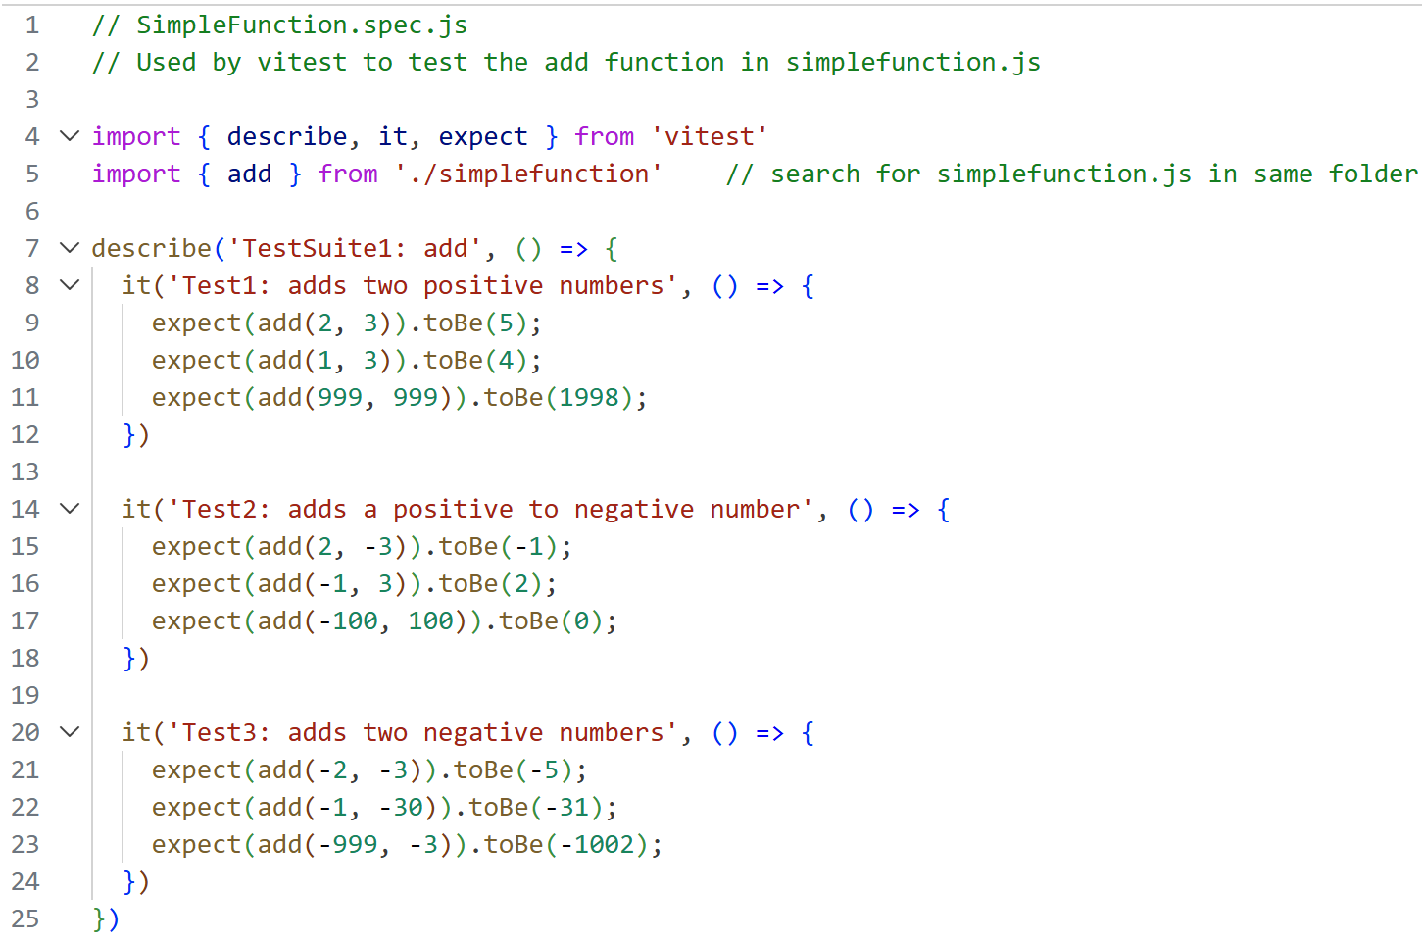
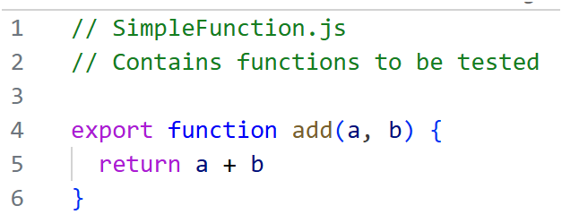
Example of Unit Testing (for a JavaScript Function)
Test code:
Function to be tested:
Vitest is a modern unit & integration testing framework for JavaScript apps optimized for projects built with Vite (e.g. Vue3 apps).

Slide 10
Example of Unit Testing (for a JavaScript Function) (2)
describe() defines a test suite (a group of related test cases). In this case, the name of the test suite is "TestSuite1: add")
.toBe(…) is a matcher that checks whether the actual result is exactly equal to 5.
expect(…) creates an expectation: it specifies the actual result that you want to check.
So expect(add(2,3)) takes the actual result returned by add(2,3), which should be 5.
This statement:
expect(add(2,3)).toBe(5);
Is an assertion
it(…) defines an individual test case.
The test case name here is "Test1: adds two…".
You can either use it() or test(), they are identical & can be used interchangeably.
Note: please stick to either it() or test() in your script for consistency
In plain English:
In the test suite for the add function, verify that:
adding 2 & 3 produces 5,
adding 1 & 3 produces 4
adding 999 & 999 produces 1998.

Slide 11
Matchers
There are other matchers besides toBe():
Matcher | What it checks
toEqual() | Deep equality of objects/arrays (contents, not identity)
toBeTruthy() / toBeFalsy() | Whether a value evaluates to true/false in a boolean context
toHaveLength() | The .length of a string or array
toContain() | Whether an array/string contains an item/substring

Slide 12
Matcher: toEqual()
Test code:
Function to be tested:
describe('TestSuite: makeStudent', () => {
it('Test1: creates a student object with correct fields', () => {
// This FAILS — two different objects are never === equal
// expect(makeStudent('Alice', 101)).toBe({ name: 'Alice', id: 101, courses: [] })
// This PASSES — toEqual() compares contents recursively
expect(makeStudent('Alice', 101))
.toEqual({ name: 'Alice', id: 101, courses: [] })
})
})
function makeStudent(name, id) {
return
{ name: name, id: id, courses: [] }
}
toBe() asks: "Are these the same object in memory?"
toEqual() asks: "Do these objects have the same contents?"
Rule of thumb: primitives → toBe(); objects & arrays → toEqual()

Slide 13
Matcher: toBeTruthy() / toBeFalsy()
Test code:
Function to be tested:
describe('TestSuite: isValidUsername', () => {
it('Test1: a valid username is truthy', () => {
expect(isValidUsername('jacky')).toBeTruthy() // 'jacky' → truthy
})
it('Test2: a too-short username is falsy', () => {
expect(isValidUsername('ab')).toBeFalsy() // '' → falsy
})
})
function isValidUsername(username) {
// returns the username if valid
// otherwise an empty string
return username.length >= 3 ? username : ''
}
Note: JavaScript's falsy values
false, 0, '' (empty string), null, undefined, NaN
toBeTruthy() would pass for 1, 'yes', []

Slide 14
Matcher: toHaveLength()
Test code:
Function to be tested:
describe('TestSuite: getTopScorers', () => {
const students = [
{ name: 'Amy', score: 90 }, { name: 'Ben', score: 75 }, { name: 'Cara', score: 88 }
]
it('Test1: returns 2 students scoring at least 85', () => {
expect(getTopScorers(students, 85)).toHaveLength(2)
})
it('Test2: returns an empty array when no one qualifies', () => {
expect(getTopScorers(students, 100)).toHaveLength(0)
})
})
function getTopScorers(students, minScore) {
return
students.filter(s => s.score >= minScore)
}
toHaveLength(n) checks that the value's
.length property equals n.
Works for arrays: expect([1, 2, 3]).toHaveLength(3)
Works for strings: expect('SMU').toHaveLength(3)

Slide 15
Matcher: toContain() -- Membership Checks
Test code:
Function to be tested:
describe('TestSuite: getEnrolledCourses', () => {
const student = { name: 'Dana', courses: ['IS216', 'IS113'] }
it('Test1: student is enrolled in IS216', () => {
expect(getEnrolledCourses(student)).toContain('IS216')
})
it('Test2: works on strings too (substring check)', () => {
expect('Web Application Development II’).toContain('Development')
})
})
function getEnrolledCourses(student) {
return student.courses // e.g., ['IS216', 'IS113']
}
On an array → checks whether the item is an element of the array.
On a string → checks whether it contains the substring.
Check out these for partial matches
Partial object match:
https://vitest.dev/guide/learn/matchers.html#objects
Asymmetric-matches: https://vitest.dev/guide/learn/matchers.html#asymmetric-matchers

Slide 16
Negating Matchers with .not
Every matcher can be flipped with .not:
expect(add(2, 2)).not.toBe(5)
expect('SMU').not.toHaveLength(5)
expect(['IS216']).not.toContain('IS113')
expect(makeStudent('Alice', 101)).not.toEqual({ name: 'Bob', id: 2 })
expect(isValidUsername('jacky')).not.toBeFalsy()
.not asserts the opposite of the matcher — useful for checking that something did not happen.

Slide 17
Setting Up for Ex1
Open terminal and install Vitest
pnpm add -D vitest
The "-D" flag means "install as a development dependency"
Open resource/Ex1 folder in VS code
Read SimpleFunction.js which contains a JavaScript function called add that is to be tested.
Read SimpleFunction.spec.js. This file contains the test cases for the add function.

Slide 18
Ex1: Unit Test for Functions
In the terminal window, execute the test using only SimpleFunction.spec.js:
pnpm vitest SimpleFunction.spec.js
Observe the results
Now, edit SimpleFunction.spec.js to insert a 4th test case. This test case can be to add zero to a positive integer. Save the file.
Notice that when you modify and save SimpleFunction.spec.js, the test reruns automatically in the first terminal window. In this terminal window, you can press "q" to quit the test.
Read MoreFunctions.spec.js. This file contains more functions to be tested, & their respective tests. (We usually place them in separate files, but in this case, they are placed in the same file for convenience). Be familiar with other matchers besides toBe().
Run the tests:
pnpm vitest MoreFunctions.spec.js
Observe the results.
Note: just running "pnpm vitest" without specifying a file will run all *.spec.js (and *.test.js) files in the same folder.

Slide 19
Take Away Message
Definitions of:
Verification vs. validation
Regression testing
Test-Driven Development
Load testing
Different types of testing: Unit testing vs. integration testing vs. E2E testing.
Practical testing skills:
Write & run a unit test for a JavaScript function using Vitest
Be familiar with how to use the following functions in Vitest scripts: describe(), it()/test(), expect(), toBe() and other matchers such as toBeTruthy(), toHaveLength(), toEqual() etc.

